Slide 1
Celebrity Activism on Weibo: Performance, Style, and Social Networks
Weiyu ZHANG, CNM, NUS
Jia DAI, Tian YANG, Tsinghua Univ.

Slide 2
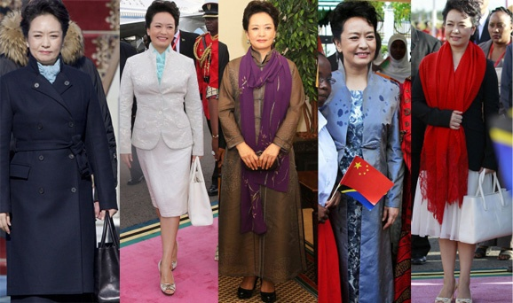
Notes:
Formerly a popular singer. 1st Spring Festival Gala.
Become part of national image
Bring sense of familiarity to the new political leadership
Liyuan Style

Slide 3
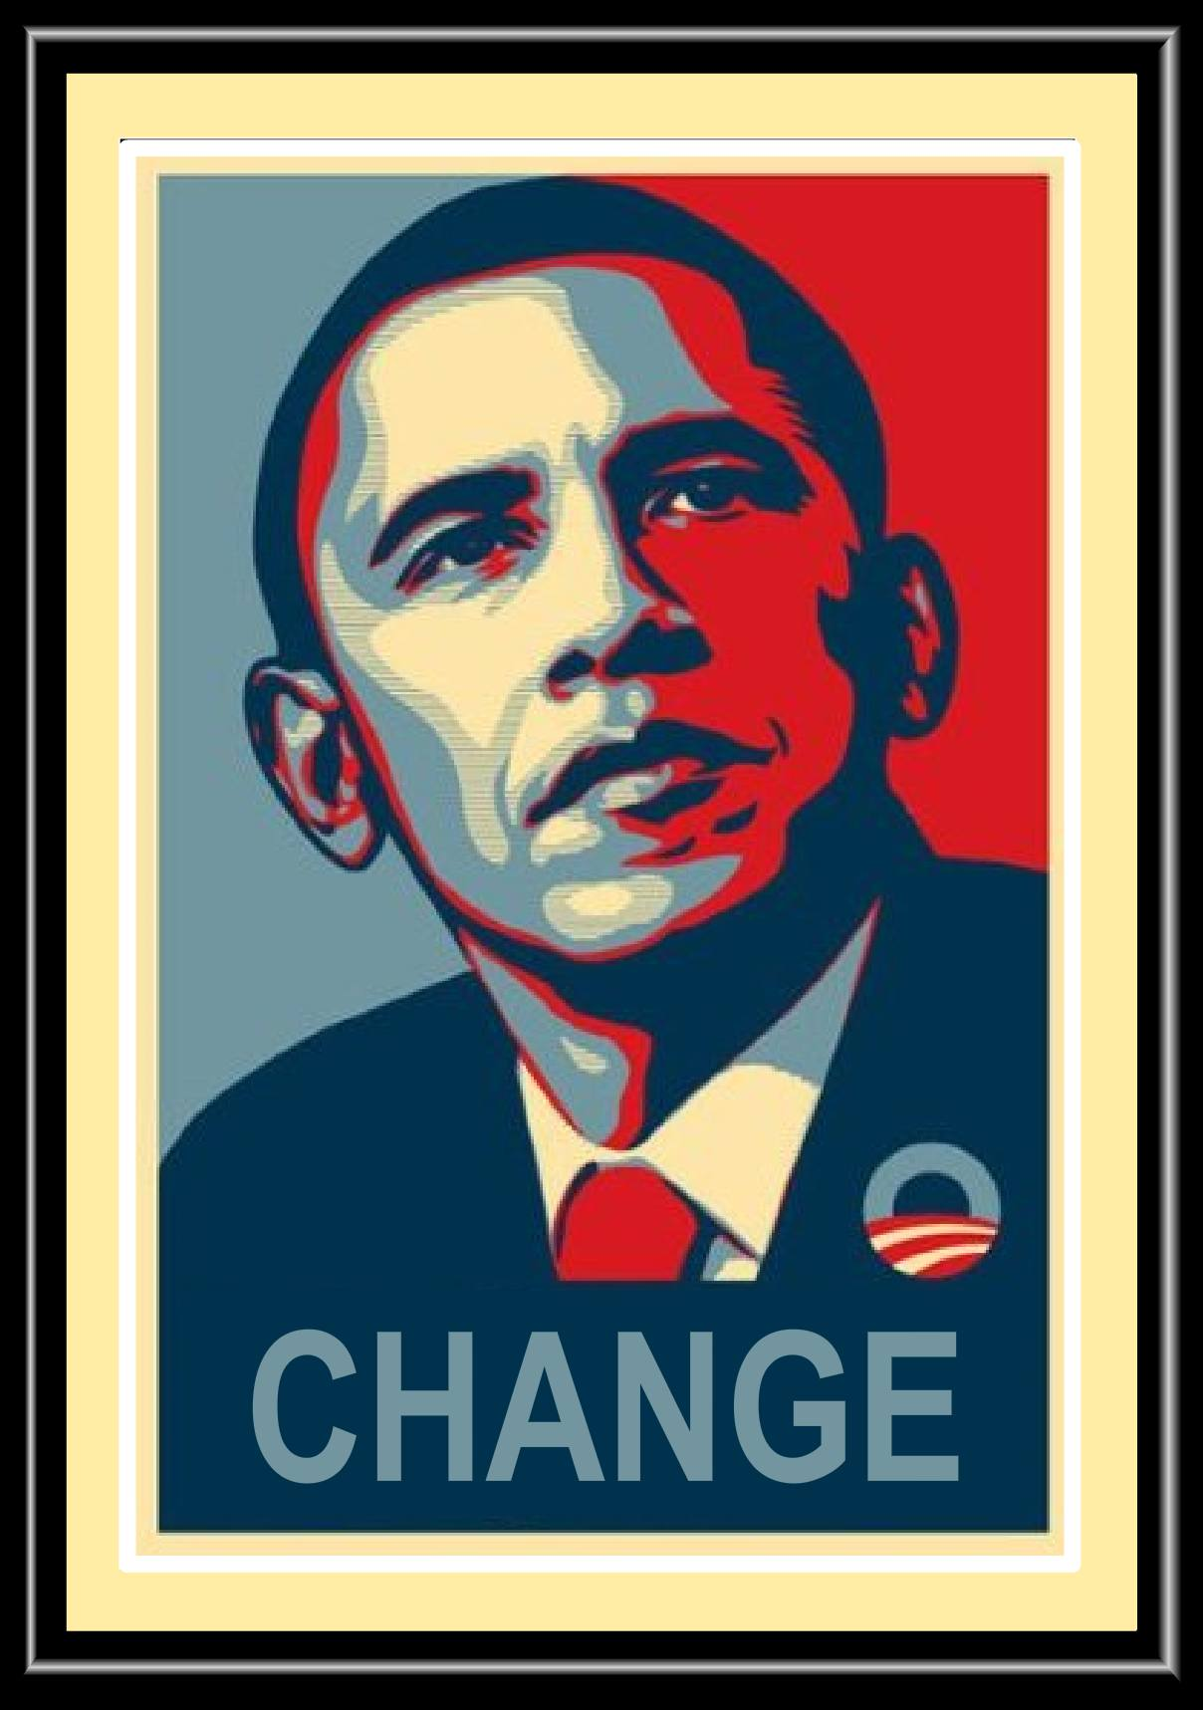
Popular Culture and Politics
World-wide phenomenon: A blurring boundary
  The roles of politicians and superstars become increasingly interchangeable
  Entertainment programs such as late night comedy shows and soap operas become the sources of political knowledge for many young audiences
  When engagement in formal political activities such as reading political news and voting are found to be less popular than before
Notes:
While movie stars are elected into offices, political candidates extensively take advantage of popular culture to win votes (Kellner, 2009).

Slide 4
Should we be worried?
Popular culture that is aimed to entertain turns rational citizens into passive spectators and fanatic followers.
Fascination with celebrities raises the risk of more superficiality and less substance in political processes.
Notes:
“politicians get judged by their ability to deliver crisp sound bytes more than by their substantive knowledge.”

Slide 5
Should we be intrigued?
“popular culture has always been a part of political communication.” (Street, 2003)
“entertainment is a central part of the human experience.” (Oliver & Raney, 2014)
Politics as rational debate vs. politics as power competition vs. politics as performance

Slide 6
Celebrity performance of politics
Celebrities use social or political causes as a way to keep their names in news. (West, 2000)
They invite their supporters/audiences to make emotional investment in them through performing their personalized sides in a public sphere. (Van Zoonen, 2004)
The importance of mediation
  famous for being famous
Notes:
“ascribed celebrity” which concerns linkages such as family connections, “achieved celebrity” which is won by outstanding achievement in fields such as sports, and “attributed celebrity” which builds its fame on media representation (i.e., famous for being famous). Rojek (2001)

Slide 7
Research Agenda
To what extent, such performance is made?
Which kind of style is displayed during the performance?
How does the mediation process influence the performance and its style?
How do the audiences respond to the performance or even become part of the performance?

Slide 8
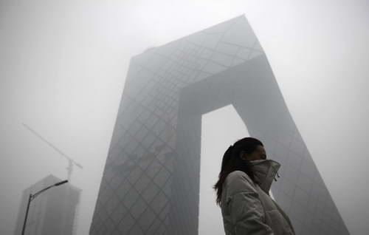
Chinese celebrities on Weibo
In China, all kinds of celebrities (e.g., movie stars, TV hosts, sportsmen, and self-made stars on the Internet) emerge out of the rapid economic growth and development of the local cultural industry.
Sina.com was a pioneer in taking advantage of celebrity power to market its digital commodities such as blogging services.
Notes:
China is an ideal place for the study of celebrity culture, because the fast development of market economy has advanced the abundance of consumer and entertainment goods, of which celebrity performance and endorsement are at the core. “Achieved celebrity” emerge in large numbers as free market economy gave birth to industry elites such as real estate developers, financial investors, and company CEOs. Meanwhile, professionalization in sports and entertainment industry led to the increase of the “attributed celebrity” which builds its fame on media representation: stars rise from almost every sporting contest and hit TV drama or movie.

Slide 9
BOURDIEU
In network analysis, the study of these underlying structures has been sacrificed to the analysis of particular linkages and flows through which they become visible.
Notes:
Bourdieu and Wacquant, 1992, p.114

Slide 10
WHO SAID WHAT
Notes:
Making the invisible structure visible
Without what, the network is empty
Without who, the content has no roots

Slide 11
Methods: Social Network Analysis
Keyword search among the top 350 celebrities in the Weibo popularity rank
Select one representative of each category of celebrities
For each celebrity, we wrote a program in Python through Weibo API to retrieve the repost structure
For each celebrity, we merge the repost structure from each post, to form a total network including all accounts involved in reposting the celebrity’s posts.
Use Ucinet to visualize the networks
Notes:
Limitation: due to Interface barriers of Sina Weibo API, we can only get up to 2000 reposts for each post. But the post that exceeds this limit is rare, so there is no problem with representativeness.

Slide 12
Methods: Content Analysis
Randomly select 10 posts (if less than 10, all posts)
Under each selected post, randomly select one page of comments (25 comments)
Codes (Percentage, 60%-100%; Correlation, about .90)
  Dates, number of retweets, number of comments, original or not, picture or not
  Van Zoonen
 | Issue | Celebrity
Deliberation | D-I | D-C
Emotion | E-I | E-C

Slide 13
To What Extent
Celebrities | Categories | # of PM2.5 tweets | Original | Average # of retweets | Average # of Comments
Pan Shiyi | Entrepreneurs | 166 | 100 | 962 | 479
Yao Chen | Entertainment/Sports | 13 | 8 | 5763 | 3122
Xu Xiaonian | Academic | 7 | 3 | 691 | 273
Li Kaifu | Entrepreneurs | 24 | 4 | 1822 | 744

Slide 14
Style
 | Deliberation-Issue | Deliberation-Celebrity | Emotion-Issue | Emotion-Celebrity
Pan Shiyi | 90% | 20% | 20% | 20%
Yao Chen | 60% | 0% | 70% | 20%
Xu Xiaonian | 57% | 14% | 43% | 0%
Li Kaifu | 100% | 0% | 30% | 0%
Notes:
N = 37

Slide 15
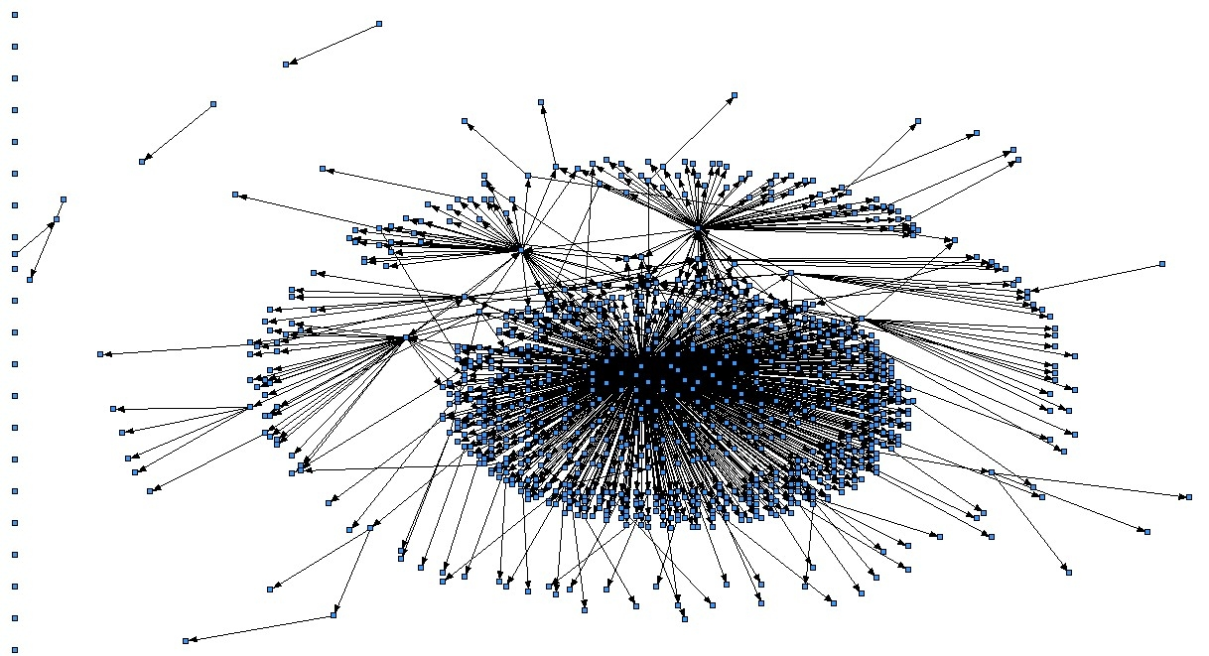
Network (Pan Shiyi)
Notes:
Betweenness measures using Pajek
：如果一个成员位于其他成员的多条最短路上，那么该成员就是核心成员，就具有较大的
中介中心性。Anthonisse(1971)和 Freeman(1977)首先对该思想进行了量化。假设：①各条线路的权系数相等；②通讯过程中总是走最短路径；③当存在不止一条最短路时，每一条的使用概率相等；中介中心性的本质是：网络中包含成员 i 的所有最短路的条数占所有最短路条数的百分比。它表示成员 i 的控制能力，或起着“gatekeeping”作用的概率。也可以理解为：成员 j 要到达网络中的所有其他成员，对成员 i 的依赖性的大小，或是成员 i 对成员 j 与网络中的其它成员进行相互作用的控制能力。

Slide 16
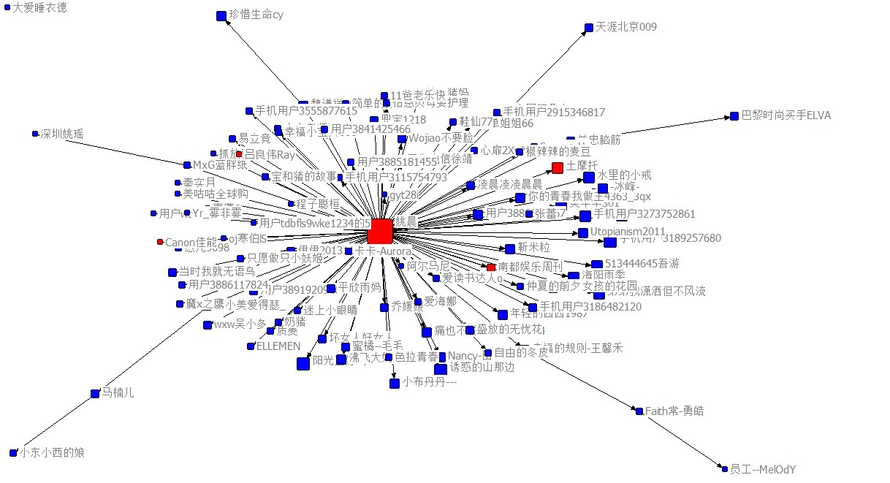
Yao Chen
Notes:
Betweenness means the number of times a node acts as a bridge along the shortest path between two other nodes.

Slide 17
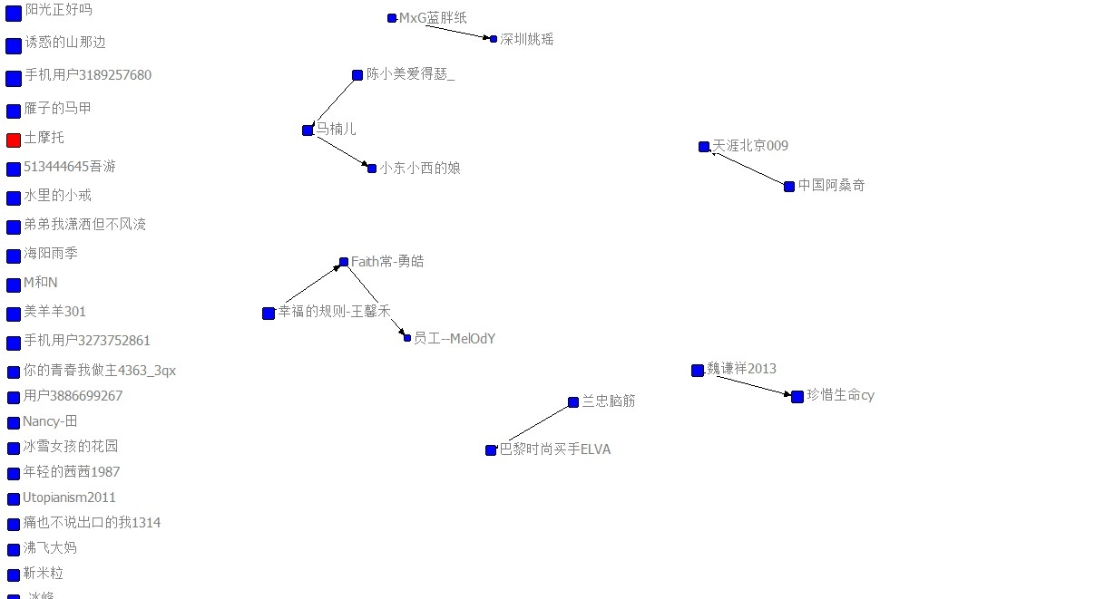
Yao Chen

Slide 18
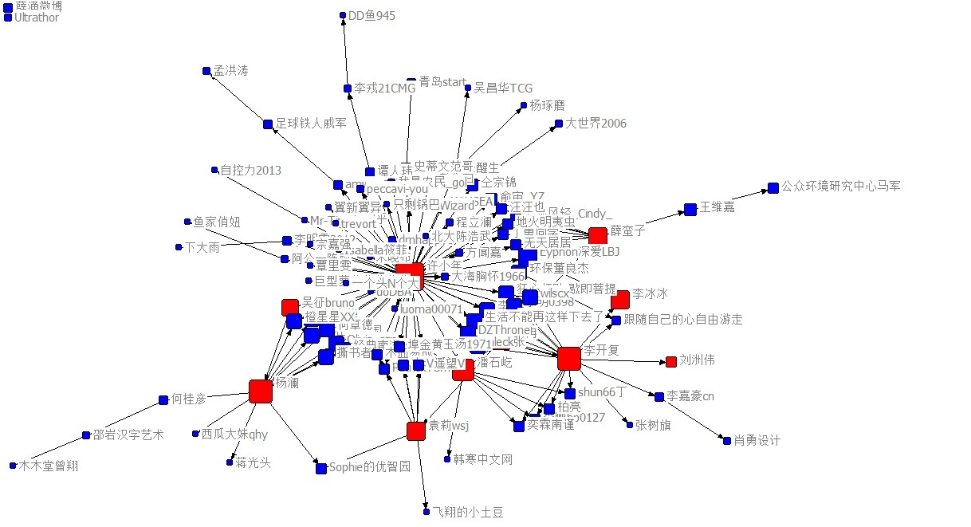
Xu Xiaonian

Slide 19
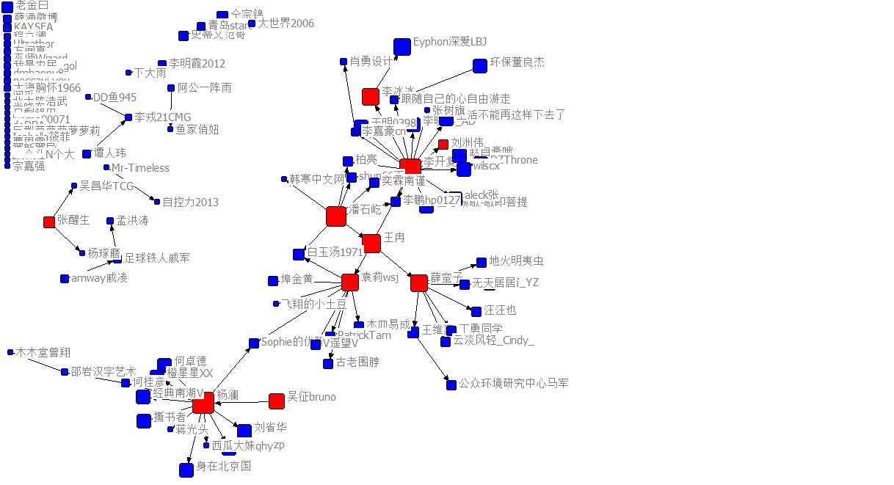
Xu Xiaonian

Slide 20
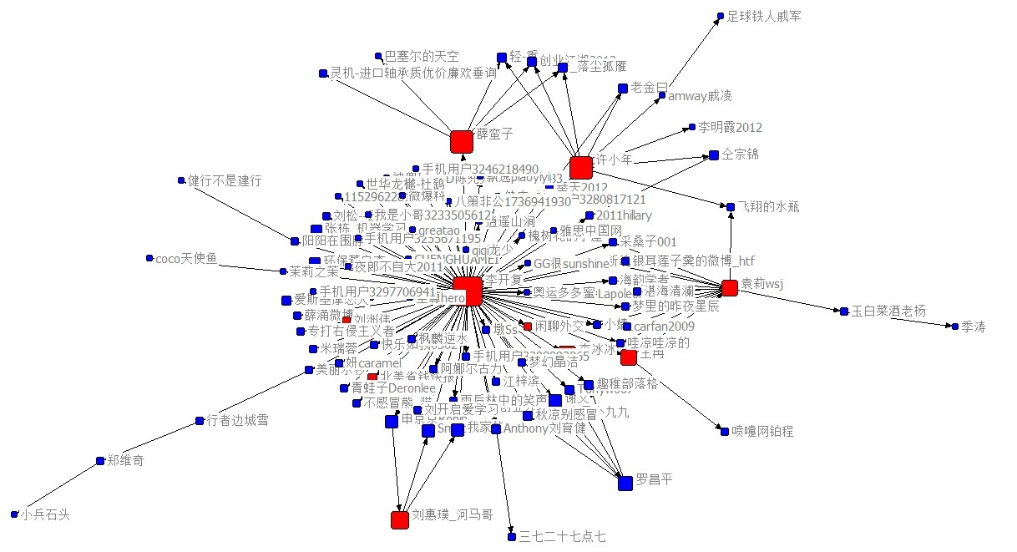
Li Kaifu

Slide 21
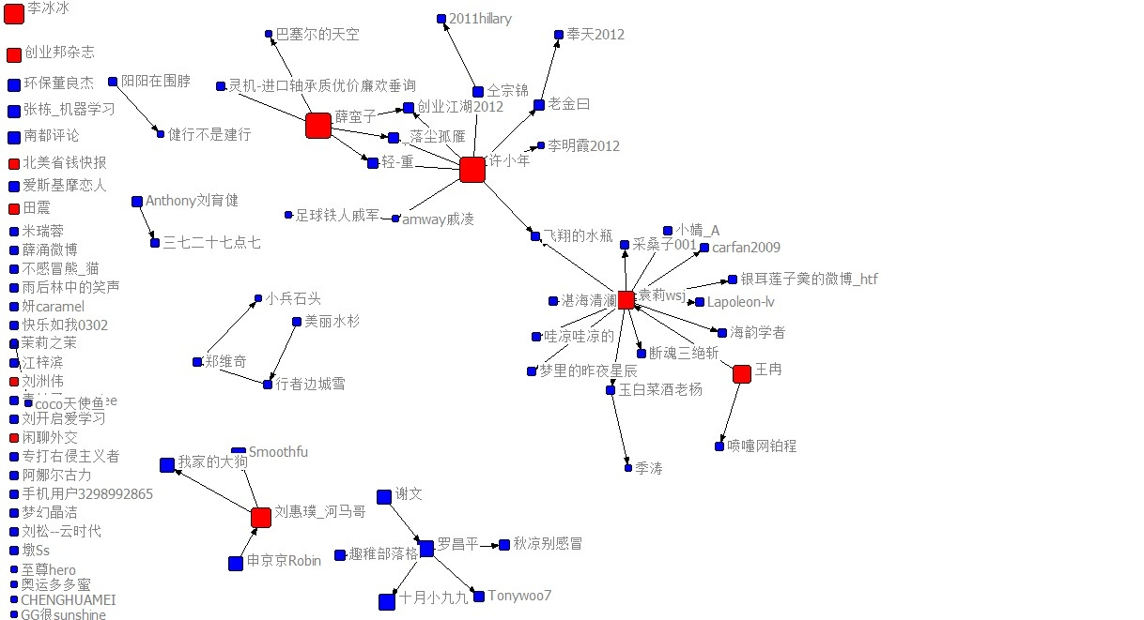
Li Kaifu

Slide 22
Influence
Both retweets and comments are driven by emotional posts addressing either the issue or the celebrity (significant correlations around .40)
 | Comments D-I | Comments D-C | Comments E-I | Comments E-C
D-I | .389*
D-C |  | .551*** | -.342*
E-I
E-C | -.629*** |  | -.566*** | .780***
Notes:
N = 37
Deliberative posts about both issues and celebrities lead to deliberative comments about both issues and celebrities. Deliberative posts about celebrity reduces emotional comments about celebrity. Emotional posts about celebrities themselves lead to emotional comments addressed to the celebrities and reduce both deliberative and emotional comments on the issue.

Slide 23
Conclusions
Extent: Social issues are regular topics mentioned by all kinds of celebrities on Weibo.
Style: Yao is more likely to mobilize emotions and draw attention to herself compared to Pan, Li, and Xu.

Slide 24
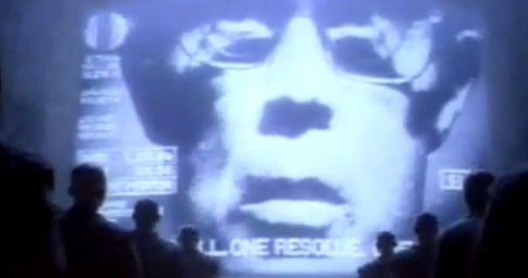

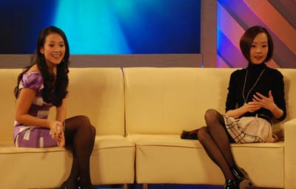
Conclusions
Network:
  Yao’s followers have neither influence nor interactions. Her network is scattered without a self-organization structure.
  In contrast, the rest show that although the celebrity is still central to the network, their followers are able to interact with each other and influence others. Their absence, however, would weaken the connectivity of the network.
Notes:
Yao is the only performer on the stage. The rest are co-performing with other actors, who have their own stages too.
Some are here to see tyra banks and some are for obama.

Slide 25
Conclusions
Influence:
  The participation of Weibo followers is more likely to be mobilized by emotional posts and less by deliberative posts.
  The deliberative/emotional nature of the posts influences the deliberative/emotional nature of the comments.
Notes:
Maybe the participation itself lacks deliberation, retweet and comment are easy to make on weibo
How much the emotional/deliberative responses would be carried into other actions/thoughts?

Slide 26
Take Home Messages
The mediation of weibo makes new types of celebrities.
Weibo celebrities tend to influence “what people feel about”.
Social network analysis has to be combined with content/textual analysis.

Slide 27
Thank you!
weiyu.zhang@nus.edu.sg
Twitter: weiyuz
Weibo: 张玮玉

Slide 28
Limitations
Sample representativeness can be made better by studying multiple cases in each category.
  Big data won’t solve the problem of representativeness.
Posts are only those that are not deleted or banned.
Intercoder reliability can be further improved.
Codes can be made more systematic and sophisticated.
  But the accuracy of machine coding is still problematic
Hierarchical Linear Models might be used because posts nest in celebrities.

Slide 29
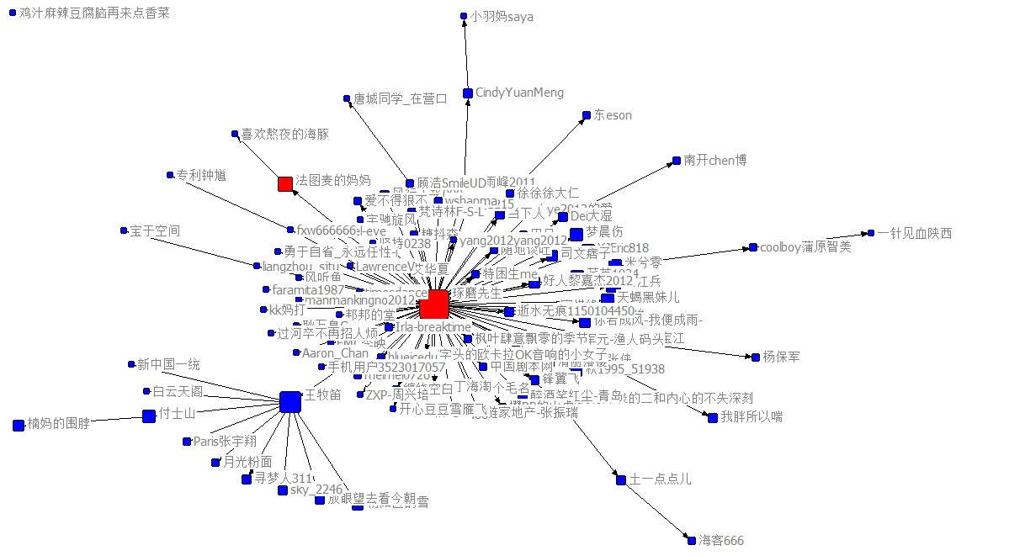
Why content has to be known?

